Slide 1
Strings

Slide 2
String Indexing
string | f | o | o | b | a | r
position | 0 | 1 | 2 | 3 | 4 | 5
string | b | o | b
position | 0 | 1 | 2
string | a | l | i | c | e
position | 0 | 1 | 2 | 3 | 4

Slide 3
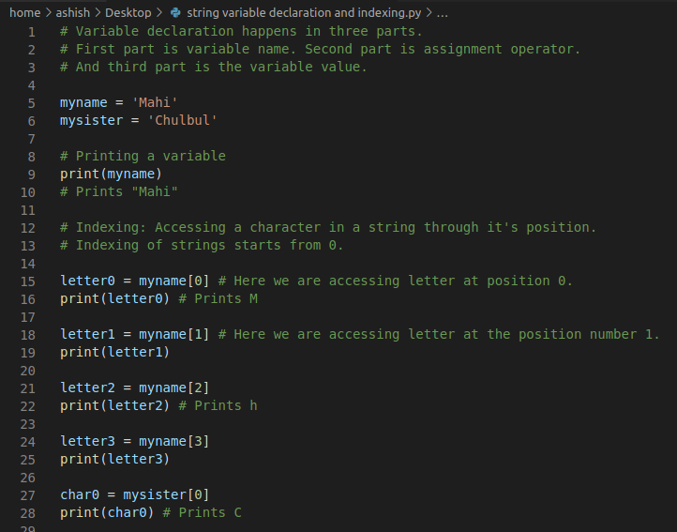

Slide 4
First Set of Questions on Strings
Declare a string variable
Print the third letter from that string
Print the length of the string variable
Reverse the string
Check if a string is a palindrome.
Q: If last index of a string is 15, what is it’s length?
Answer: 16

